Slide 1
8 LITHIUM ION CELL
Dr.Rani Pavithran
Assistant Professor & Head
Department of Chemistry
College of Engineering Trivandrum

Slide 2

2019 Nobel Prize in Chemistry
The Nobel Prize in Chemistry 2019 is awarded to John B. Goodenough (97 years) (USA), M. Stanley Whittingham (UK) and Akira Yoshino (Japan) for their contributions to the development of the lithium-ion battery.
This rechargeable battery laid the foundation of wireless electronics such as mobile phones and laptops.
It also makes a fossil fuel-free world possible, as it is used for everything from powering electric cars to storing energy from renewable sources.

Slide 3
Lithium ion cell (Li-ion battery)
Li-ion cell is a rechargeable battery in which Li-ion moves between anode and cathode during charging and discharging.
It is more popular than other batteries because of the various characteristics of Lithium.
Li has a higher negative value for reduction potential and a lower atomic mass than any other metal.
Only 6.94 g of Li is needed to provide 1 mole of electrons.

Slide 4
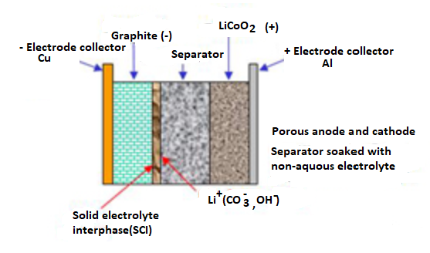
Construction of Li-ion cell
In typical lithium ion cell, the positive electrode is made by using a crystalline mixed oxide LiCoO₂ or Li₂O:Co₂O₃.
The crystal contains both Li⁺ ion and Co³⁺ ion occupying the voids of the oxide array.
Such crystals are usually synthesized by hydrolysis of the respective metal salts under hydrothermal condition.
The negative terminal is made of graphite.
The electrolyte is a solution of Li-salt (LiPF₆; LiBF₄orLiClO₄), in an organic solvent such as ether or a solid phase polymer electrolyte which can transport Li⁺ ion.
A solid electrolyte separator separate (SEI, solid electrolyte interface) the anode and cathode compartments.

Slide 5

Charging: During charging the cell act as an electrolytic cell, the electrical energy is converted into chemical energy.
Anode (+):
Here x < 1 mole, say 0.9 (or 90 percentage) ie, some Li⁺ ions get removed from the crystal lattice, and in the respective lattice sites Co³⁺ ion get oxidized to Co⁴⁺ and electrical neutrality is maintained in the lattice.
Cathode (-): The Li⁺ ion produced at the anode get migrated through the electrolyte and get reduced to lithium atom at the graphite electrode.

Slide 6
Li atoms are inserted between the layers of carbon atoms. This is called lithiated graphite, written as Li_{x}C_{G}, containing no Li metal as such. This is why Li-ion battery is not called as Li battery.
When Lithium ion cells are allowed to charge completely (x=1) anodic material becomes Li_{1-x}CoO₂ (x=1, Li₁₋₁) or CoO₂, which is an explosive material (due to liberation of O₂ gas on decomposition).
Therefore automatic built-in circuit breakers are there inside battery which allows charging only up to 90 percentage ( x= 0.9).

Slide 7


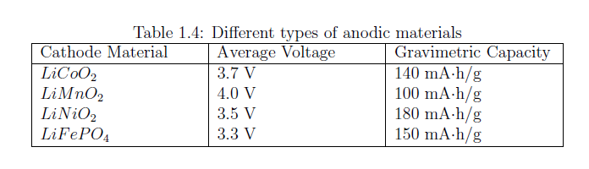
Discharging: During discharging, the cell act as an electro chemical cell, the chemical energy is converted to electrical energy. When the cell acts as an electrochemical cell, LiCoO₂ act as cathode while the graphite act as anode
Cathode(+):
Anode(-):

Slide 8
Lithium ion cell (Li-ion battery)
Lithium-ion cell based on LiCoO₂ has an EMF of 3.7 V. The cell is having high energy to weight ratio.
They are used in cell phones, laptop computers, digital cameras etc.
The cell is not suitable for making large size battery because of possibility of explosion.
Another type of Li-ion cell have been developed based on the active materials like, LiFePO₄. The cell is having a potential of 3.3V. The cell is suitable for making large size battery suitable for automobile application.
The most popular anode material is graphite; every 6 carbon atom in graphite can accommodate a lithium atom. The materials like lithium titanate , hard carbon, Tin/cobalt alloy and silicon/carbon nano-materials were also developed as anode material.

